Slide 1
Album era
MSc Data science and AI, Université Nice Côte d’Azur
Data visualization final project
Advisor: Macro Winkler
Student: NGUYEN Huyen Trang and BHAT Anjana

Slide 2
Content
Introduction
Data processing
Data visual mapping
Data visualization

Slide 3

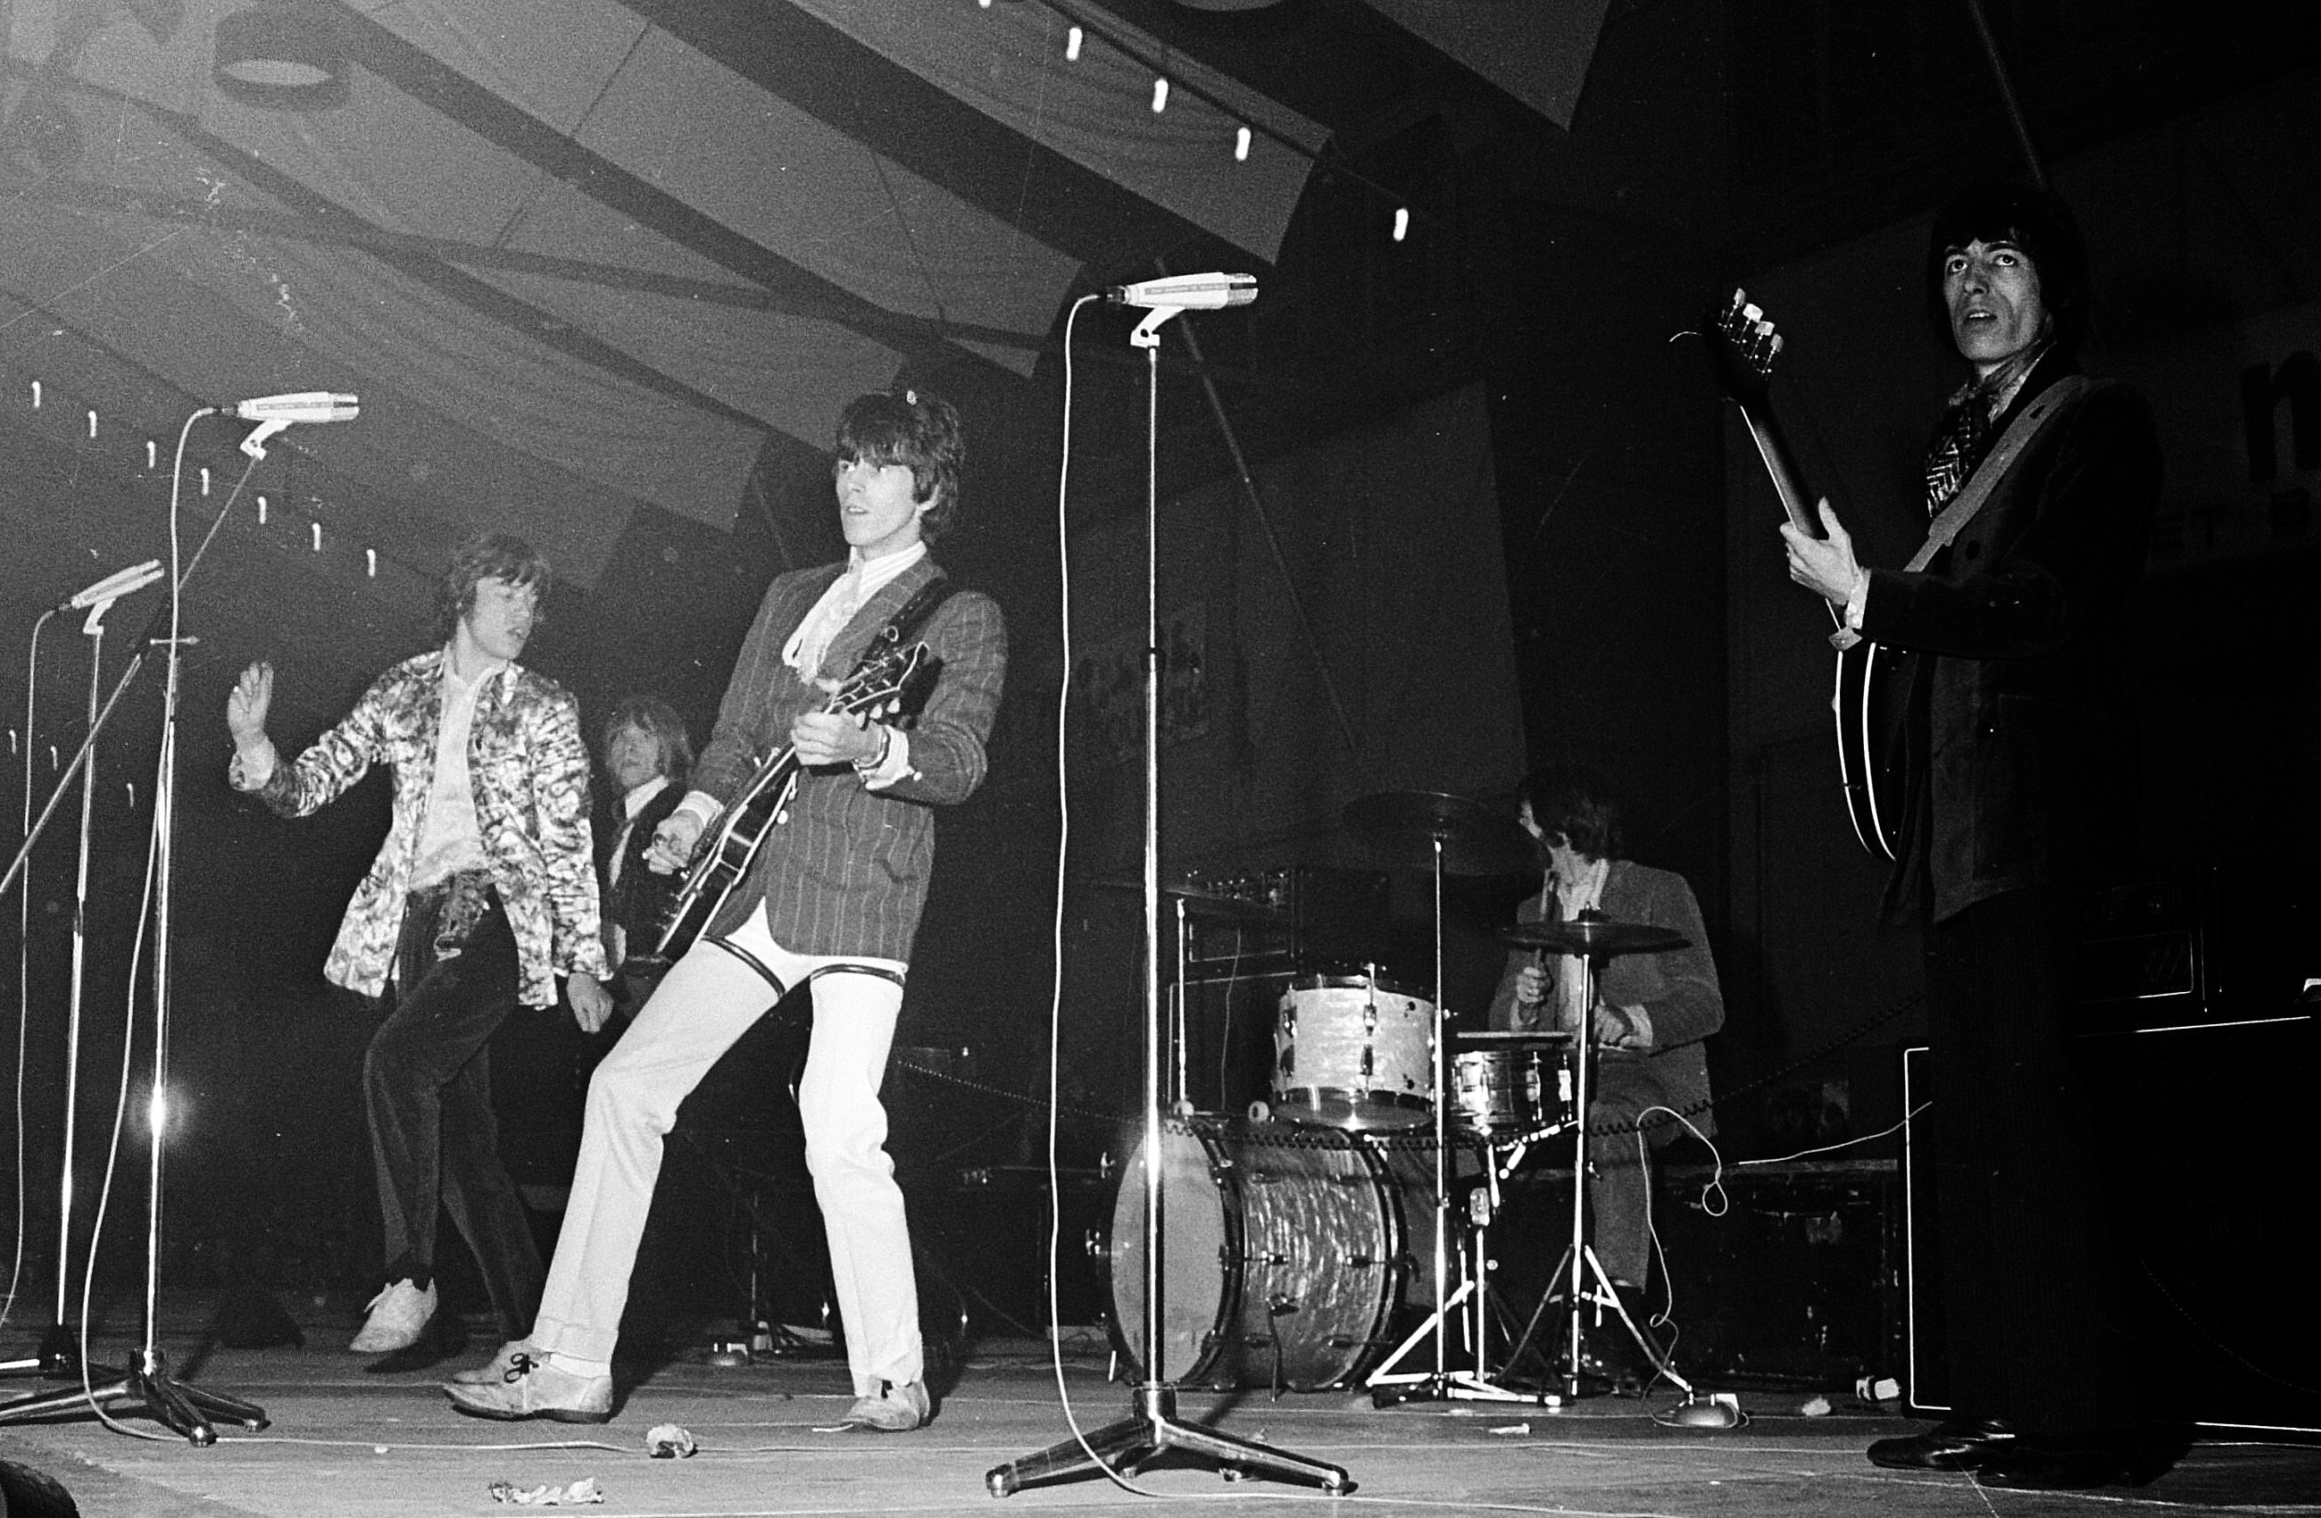
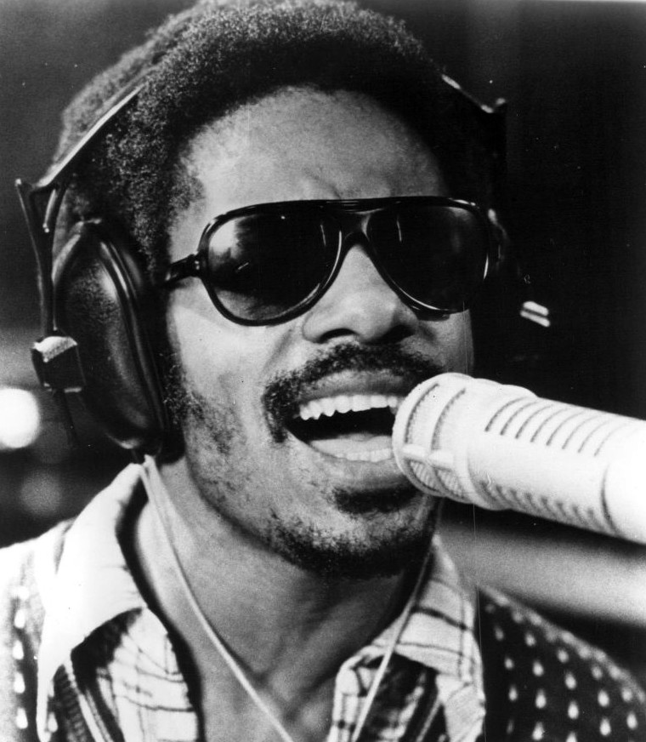


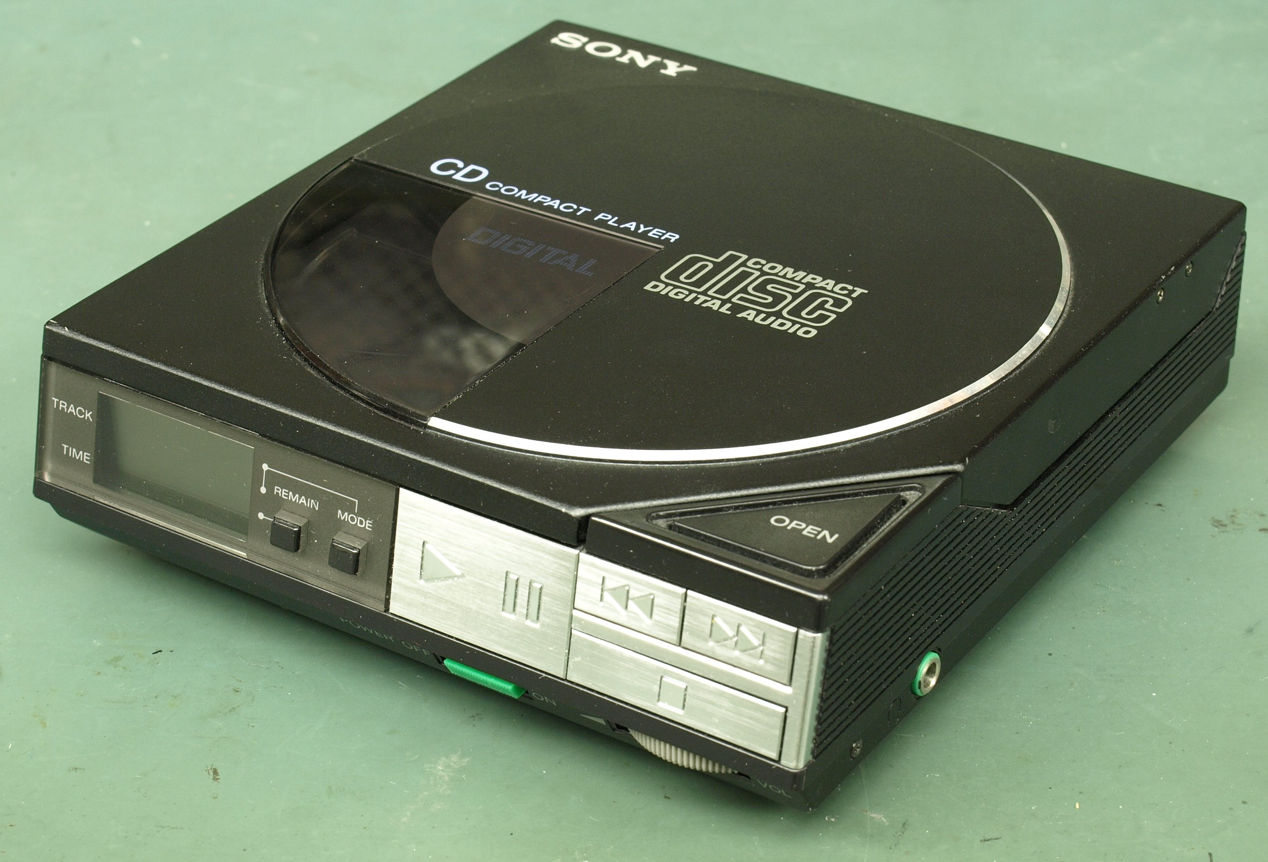
Introduction
1. Idea context
1950s: Pre-history
1960s: Rock era
1970s: Golden era
1980s-1990s: CD and cassetts
2000s: Pop and urban
2010s-present: Streaming era
Notes:
The Rolling Stones are an English rock band formed in London in 1962.
Stevie Wonder, is an American singer-songwriter, who is credited as a pioneer and influence by musicians across a range of genres that include rhythm and blues, pop, soul, gospel, funk, and jazz.

Slide 4
Introduction
2. Target users

Slide 5

Introduction
2. Target users

Slide 6

Introduction
2. Target users

Slide 7

Introduction
2. Target users

Slide 8
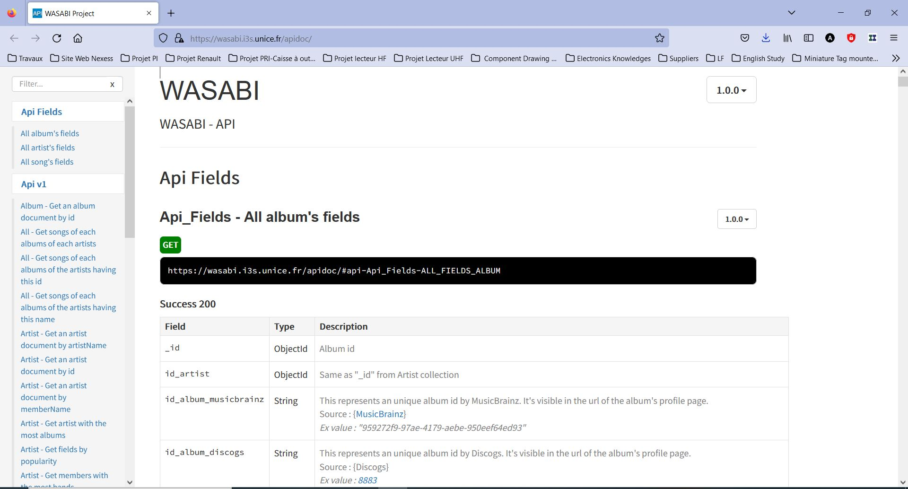
Introduction
3. Dataset

Slide 9
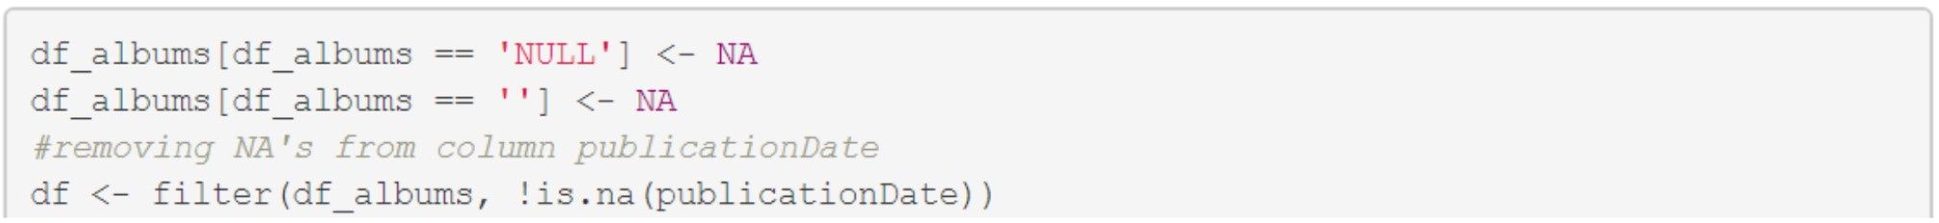
Data Processing
Step 1: Clean Missing Values

Slide 10
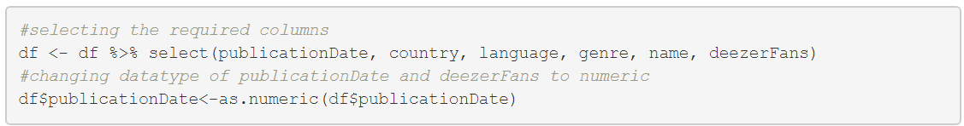
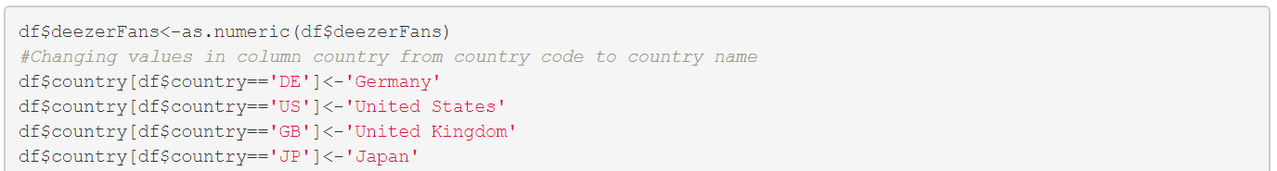
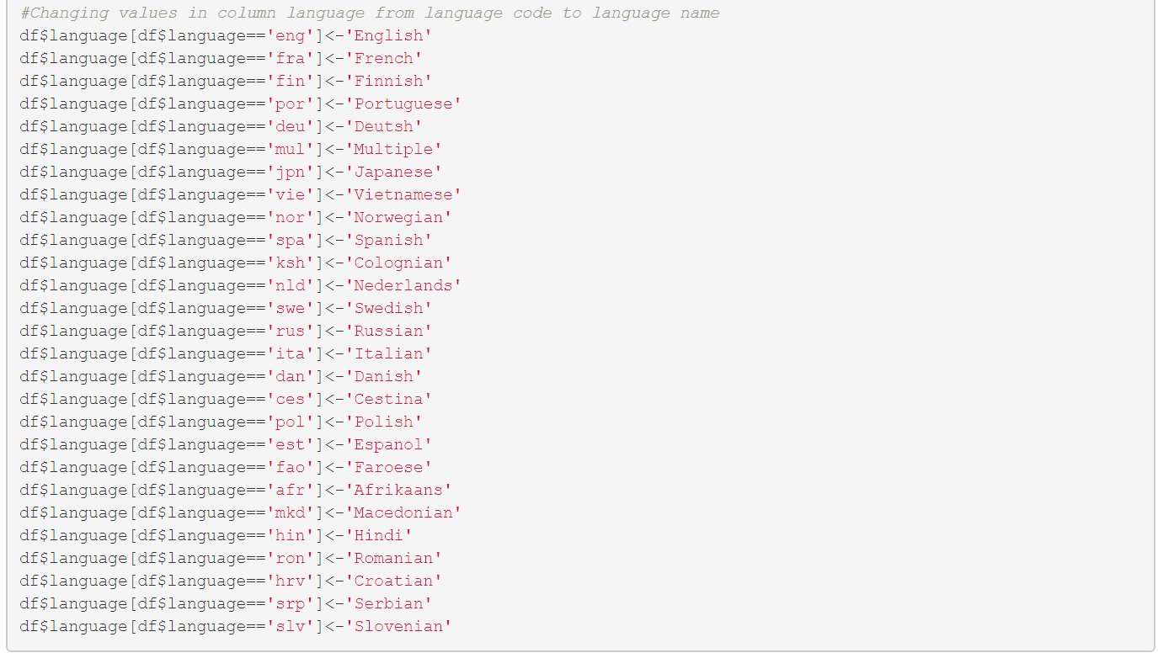
Data Processing
Step 2: Data Transformation

Slide 11
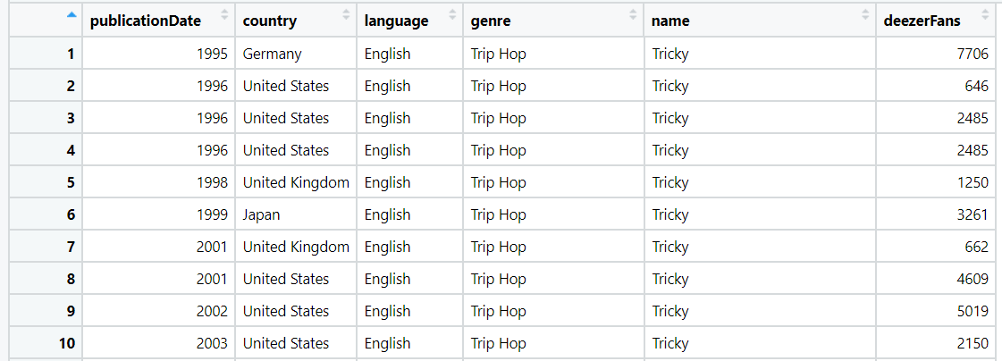
Data Processing
Step 3: Export Dataset

Slide 12

Data Processing
Step 4: Import Dataset in Power BI

Slide 13
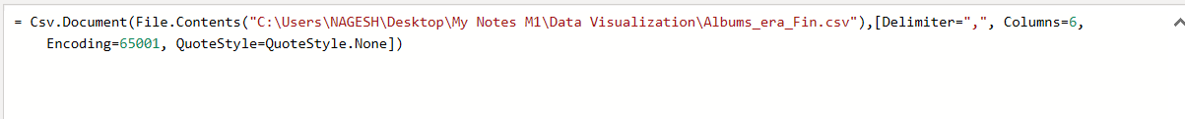
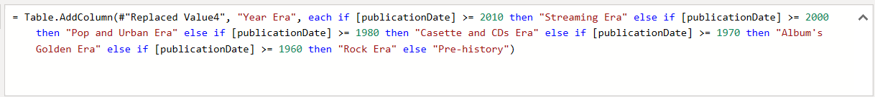
Data Processing
Step 5: Query in Power BI

Slide 14
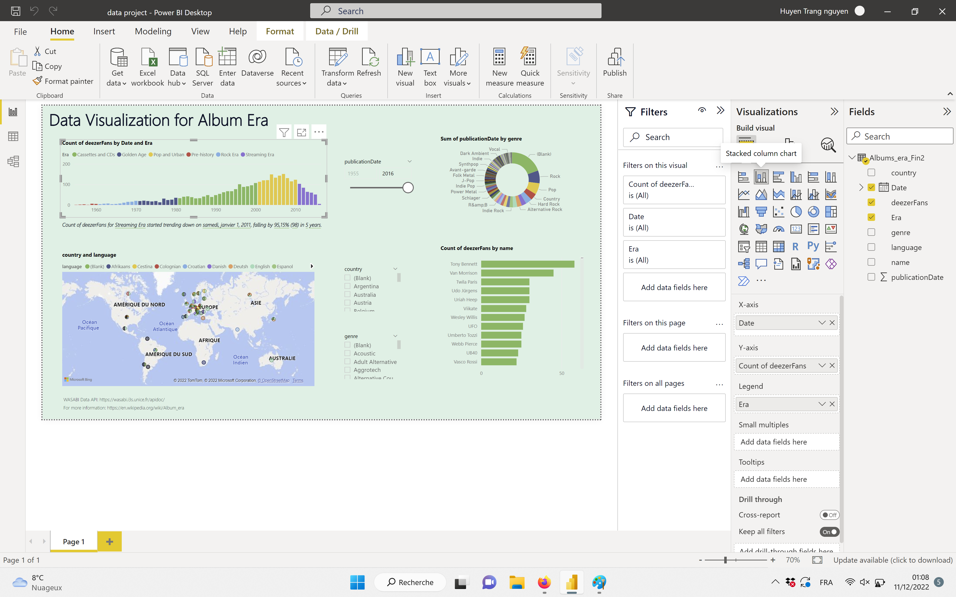
Data Processing
Step 6: Visualization

Slide 15
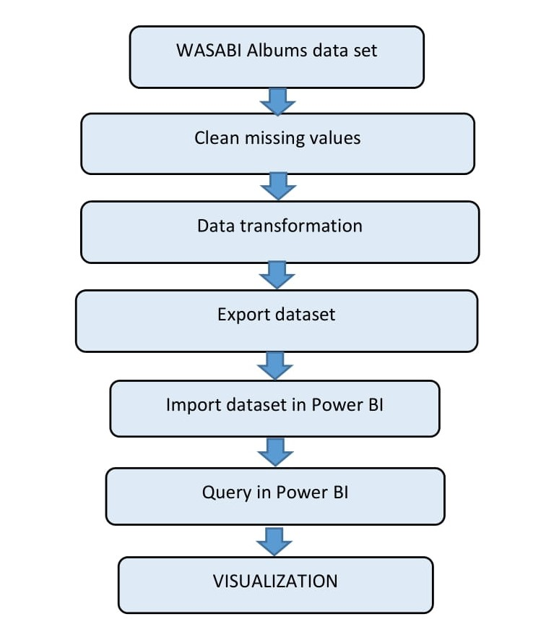
Data Processing

Slide 16
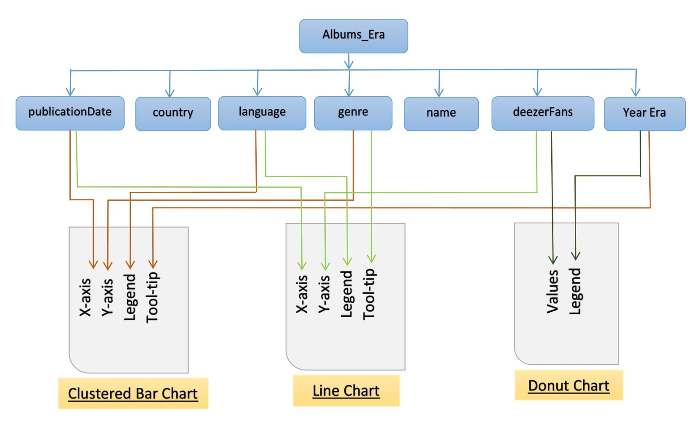
Data Visual Mapping-Anjana

Slide 17
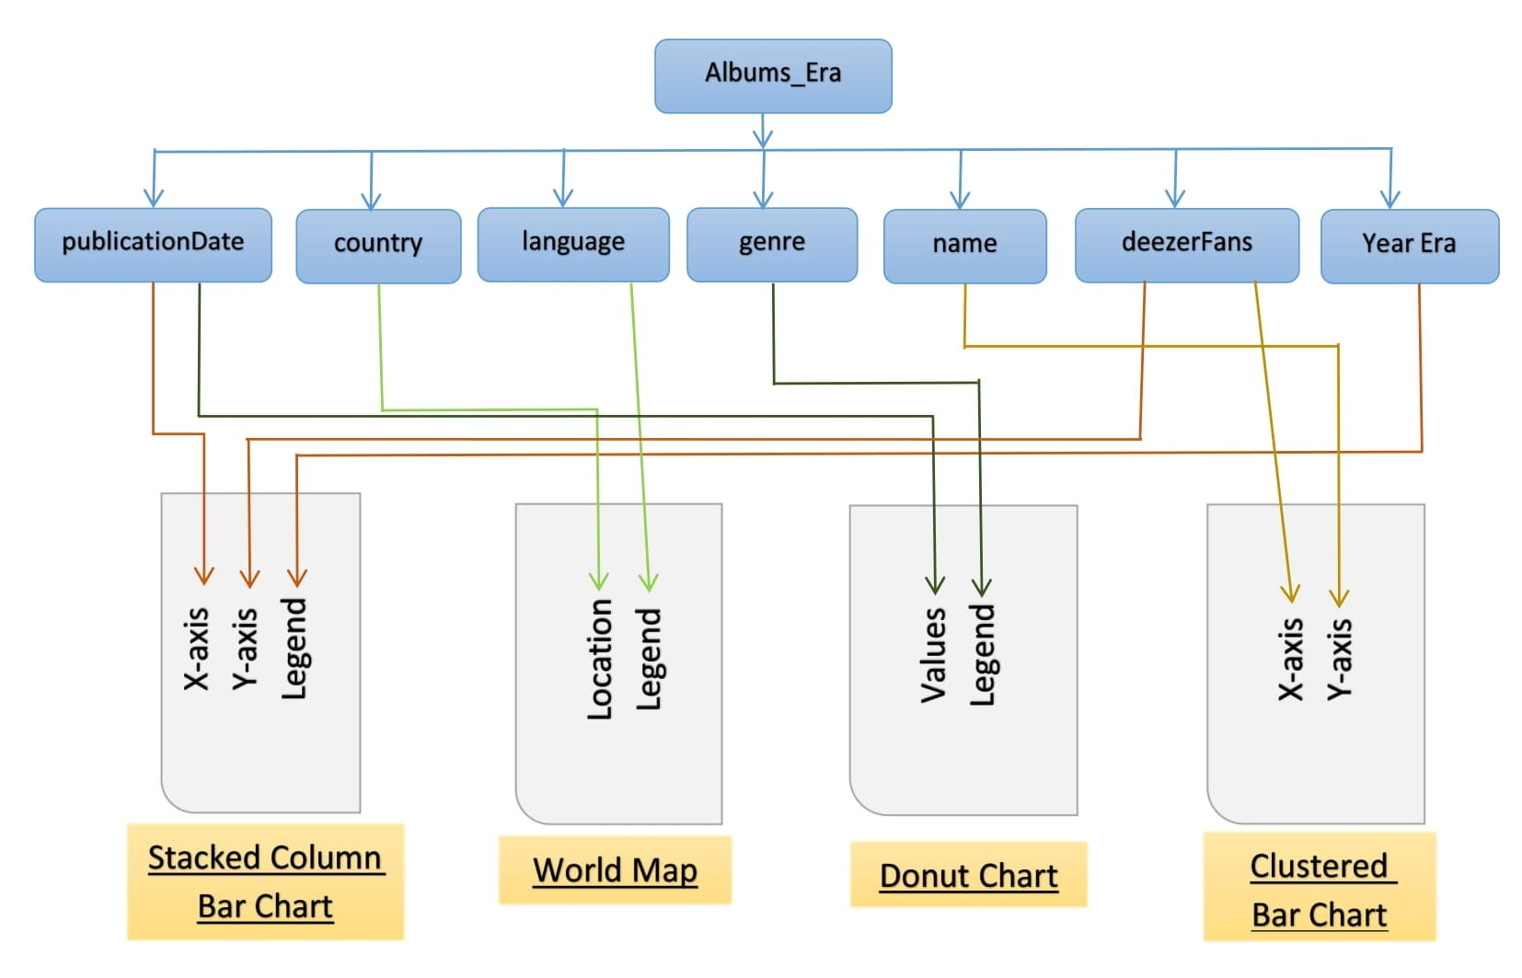
Data Visual Mapping-Huyen Trang

Slide 18
Let’s Visualize the data...

